Slide 1
Lauren Bailey
State Franchise Laws and
Regulatory Initiatives

Slide 2
Advertising Enforcement

Slide 3
Overview (Here was the situation last year)
Since March 2012, the FTC has engaged in 3 separate rounds of advertising enforcement against 17 auto dealerships in 12 states.
The actions involved ads over all types of advertising mediums.
California (4) | Michigan (1)
Connecticut (2) | North Carolina (2)
Georgia (1) | Ohio (1)
Illinois (1) | South Dakota (1)
Maryland (1) | Texas (1)
Massachusetts (1) | West Virginia (1)

Slide 4
Overview (Here’s the situation today)
Since March 2012, the FTC has engaged in 7 separate rounds of advertising enforcement against 23 auto dealerships in 15 states.
The actions involved ads over all types of advertising mediums.
Alabama (1) | Michigan (1)
California (5) | Nevada (2)
Connecticut (2) | North Carolina (2)
Florida (1) | Ohio (1)
Georgia (1) | South Dakota (1)
Illinois (1) | Texas (2)
Maryland (1) | West Virginia (1)
Massachusetts (1)

Slide 5
Compliance Guidance

Slide 6
NADA Federal Advertising Guide
Addresses 41 federal ad topics
Discount claims
Green marketing
Internet marketing
Satisfaction guarantees
Sweepstakes/Lotteries
“Trigger” terms
Provides several examples of “bad ads” and “good ads”
Does not address additional state or local requirements
Available at www.nada.org

Slide 7
NADA University Webinar
Complying with Federal Advertising Requirements
Featured two attorneys with the FTC’s Division of Financial Practices
Conducted March 19, 2014
Access by logging on to www.nadauniversity.com and entering “comply with federal advertising” in the search box

Slide 8
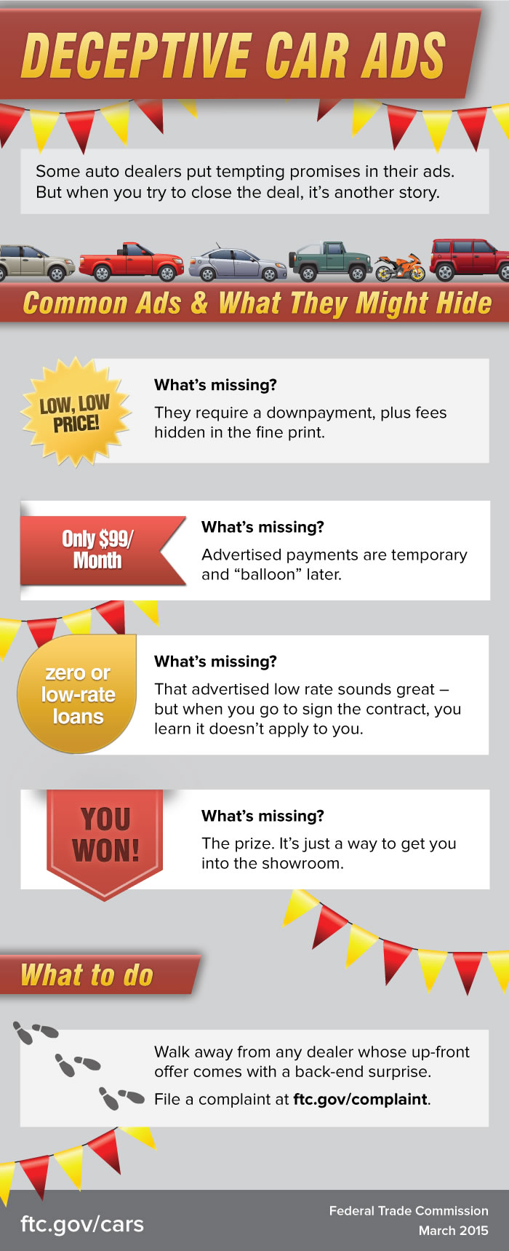
Other Federal Advertising Resources
FTC “The Auto Marketplace” Press Releases
https://www.ftc.gov/news-events/media-resources/consumer-finance/auto-marketplace
FTC auto-related blogs
https://www.ftc.gov/news-events/blogs/terms/307
FTC pub on .com disclosures
https://www.ftc.gov/sites/default/files/attachments/press-releases/ftc-staff-revises-online-advertising-disclosure-guidelines/130312dotcomdisclosures.pdf

